Slide 1

Exploring AC-GAN:
Architecture Enhancements & Impact of Image Resolution
Supervisor: Dr. Serhiy Yanchuk
Speaker: Jiaxue Zhang
University College Cork
27 September 2024

Slide 2
1
Introduction
2
Research Focus
Contents
3
Theoretical Background
4
Results and Discussion

Slide 3
1 Introduction

Slide 4
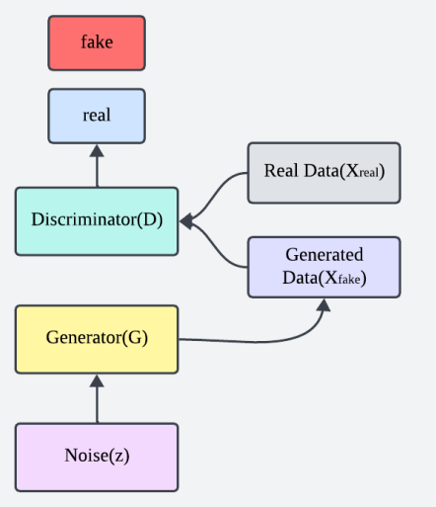
What is GAN?
Concept
Generative Adversarial Network[1]
Mission
Model Architecture
Loss Function

Slide 5
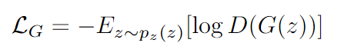
What is GAN?
Loss Function
Discriminator’s loss function：
Generator’s loss function：

Slide 6
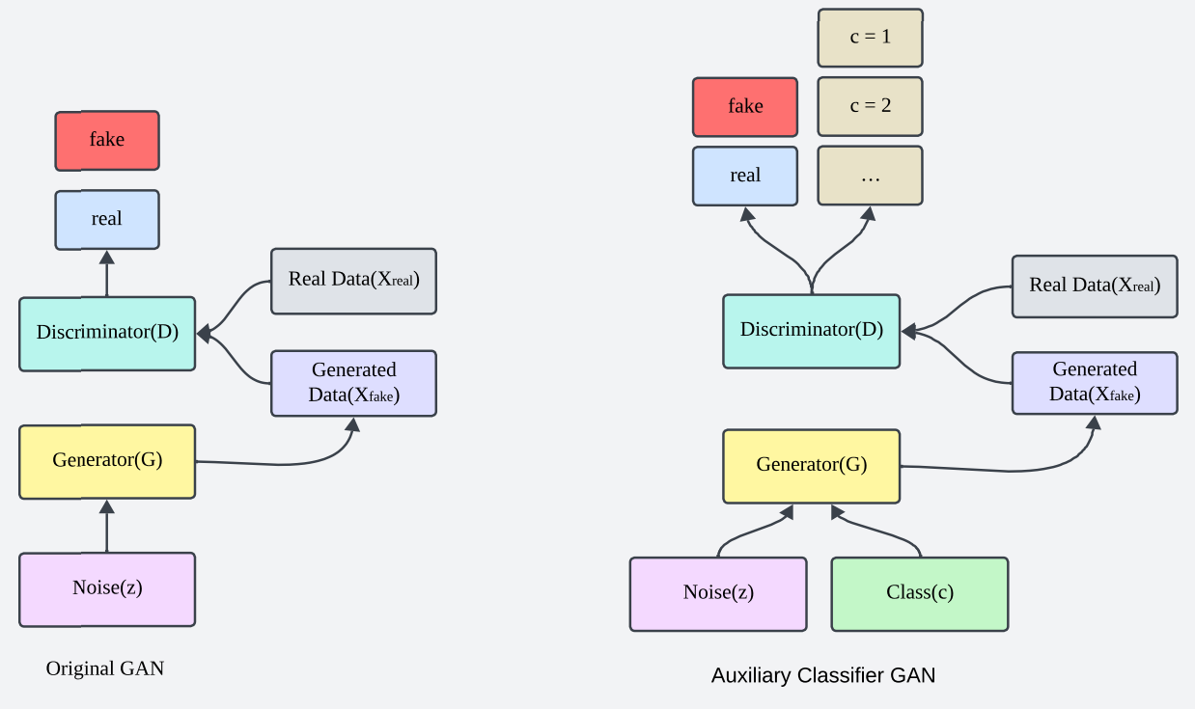
What is AC-GAN?
Concept
Auxiliary Classifier Generative Adversarial Network[2]
Mission
Model Architecture
Loss Function

Slide 7
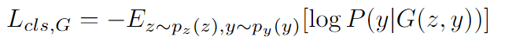
What is AC-GAN?
Loss Function
Discriminator Adversarial Loss:
Generator Adversarial Loss:
Discriminator Auxiliary Classification Loss:
Generator Auxiliary Classification Loss:

Slide 8
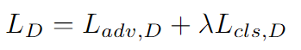
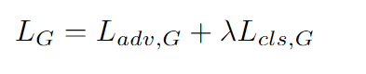
What is AC-GAN?
Loss Function
Total Loss for discriminator：
Total loss for generator：

Slide 9
2 Research Focus

Slide 10
Research Focus
1. Architecture Enhancements model——AAC-GAN
New Model Structure and Novel Loss Function Design
2. Impact of Image Resolution
Dataset Exploration: 32x32, 64x64, 128x128

Slide 11
3 Theoretical Background

Slide 12
Theoretical Background
Performance Metrics
Model Architecture
Dataset
Frechet Inception Distance (FID)
Inception Score
(IS)
Convolutional Neural Network (CNN)
Cifar-10

Slide 13
4 Results and Discussion

Slide 14
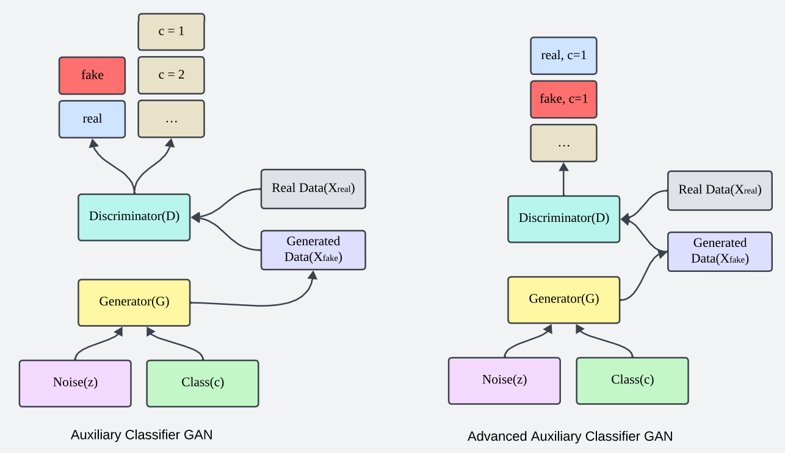
What is AAC-GAN?
Concept
Advanced Auxiliary Classifier Generative Adversarial Network
Mission
Model Architecture
Loss Function

Slide 15
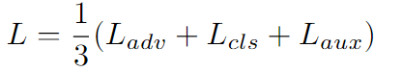
What is AAC-GAN?
Loss Function
Adversarial Loss：
Classification Loss：
Auxiliary Loss：

Slide 16
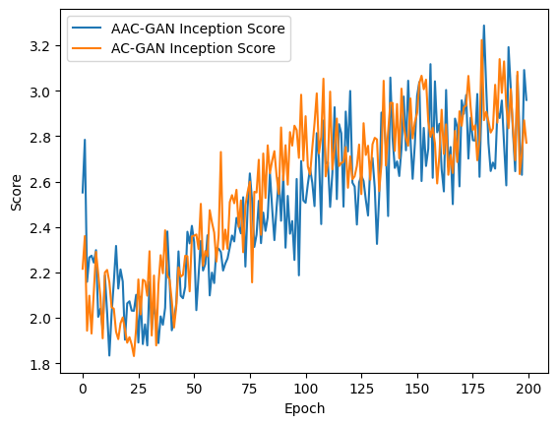
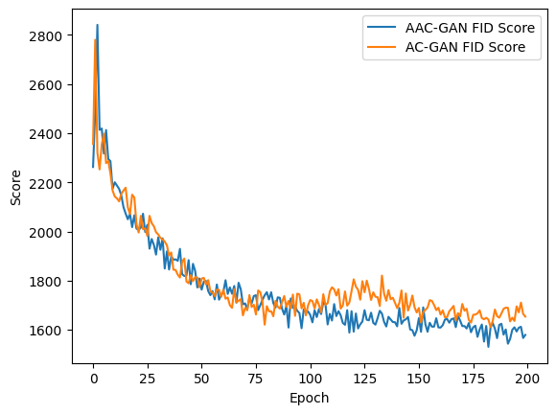
AC-GAN VS AAC-GAN
IS score
FID score
epoch*10
epoch*10

Slide 17
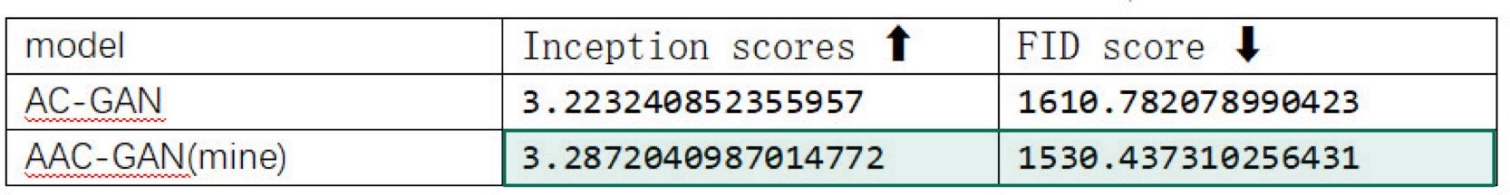
AC-GAN VS AAC-GAN
Average FID and IS Score Comparision

Slide 18


Experimental Results of different pixel
datasets
32x32, 64x64, and 128x128 pixels cifar-10 dataset
AC-GAN model
FID and IS score

Slide 19
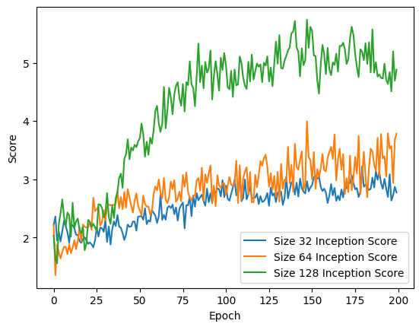
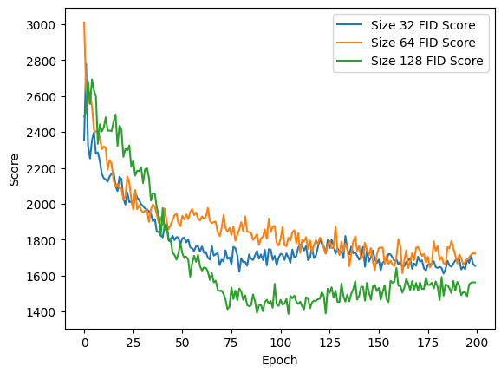
Impact of Image Resolution
IS Score
FID Score
epoch*10
epoch*10

Slide 20
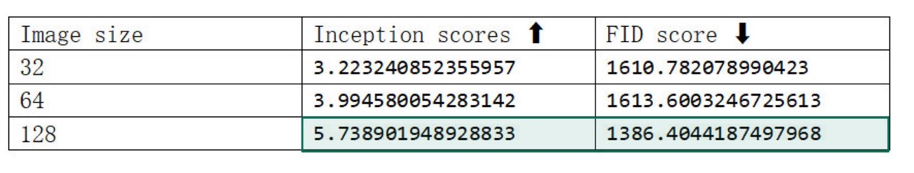
Impact of Image Resolution
Average FID and IS Score Comparision

Slide 21
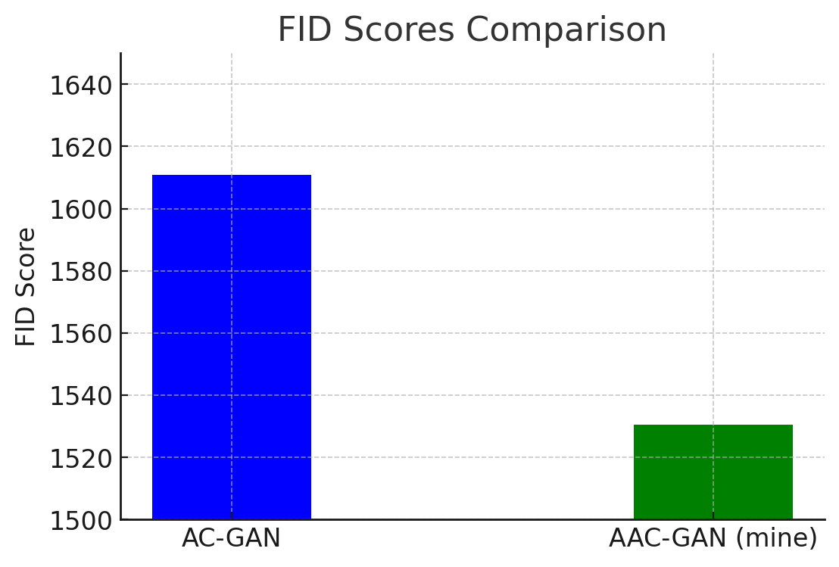
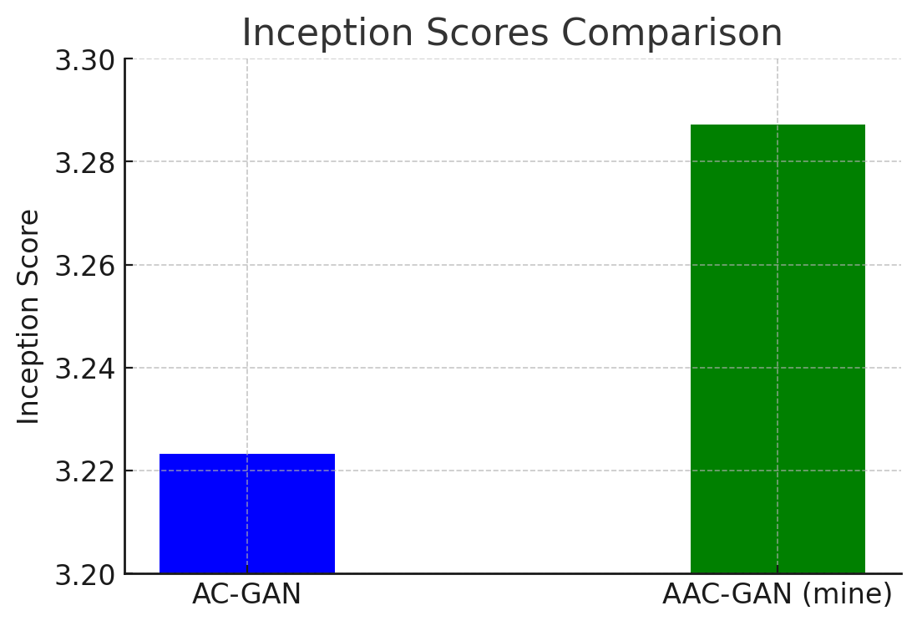
Summary
AC-GAN vs AAC-GAN
AAC-GAN performs better than AC-GAN！

Slide 22
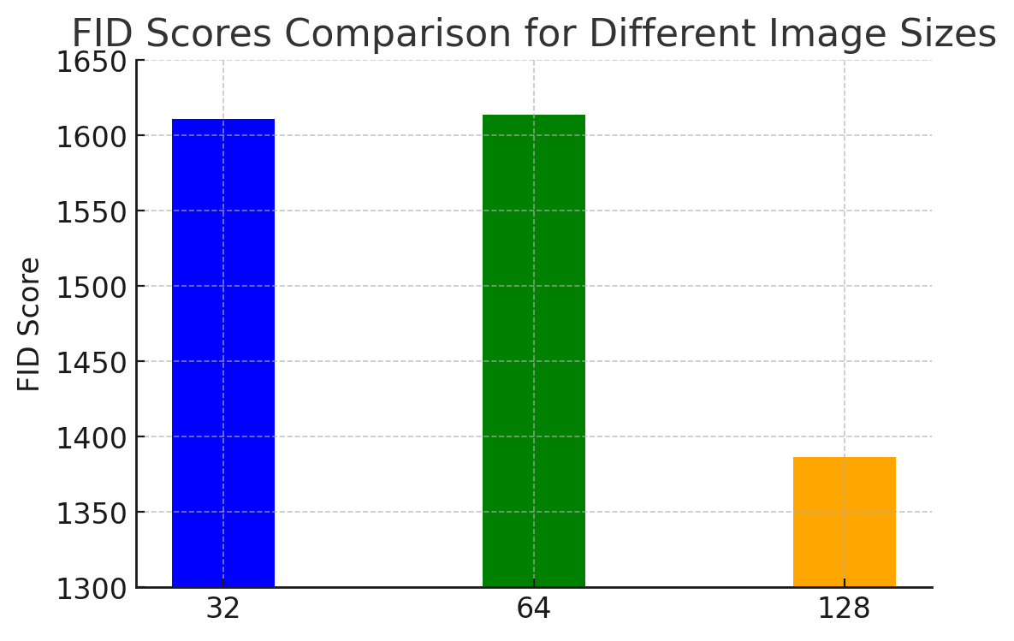
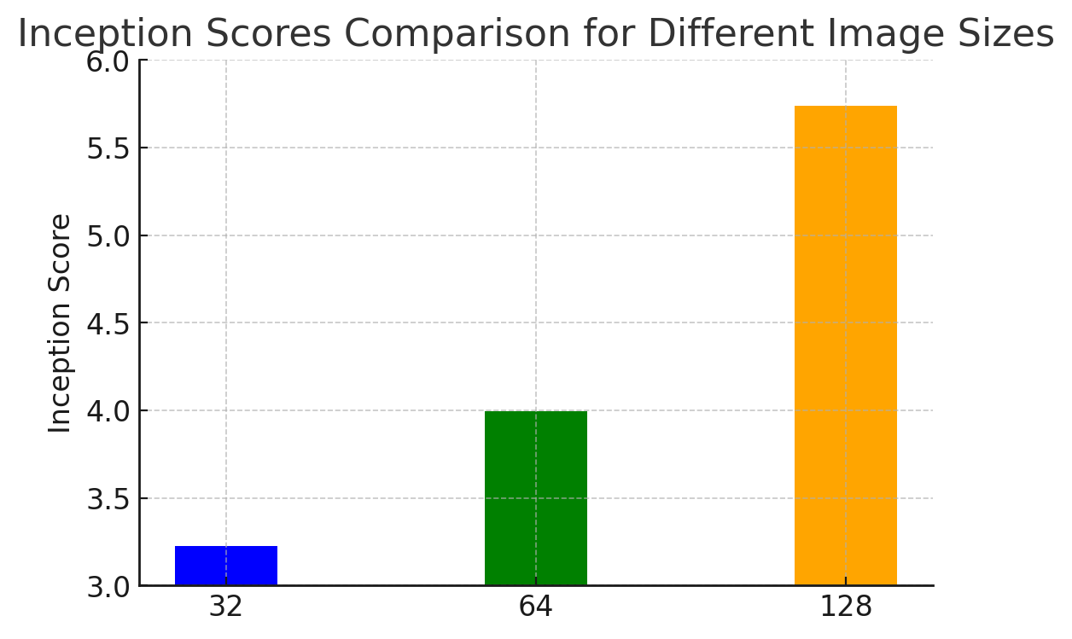
Summary
Impact of Image Resolution
Larger image sizes lead to better performance!

Slide 23
What can we do in the future?
For AAC-GAN
01
Implementing Cooling Training Strategy[3]
02
Addressing Computational Constraints
03
Further Optimization of Model Architecture

Slide 24
What can we do in the future?
For the Impact of Image Resolution
01
Exploring Higher Resolutions
02
Optimizing Data Preprocessing
and Augmentation Methods

Slide 25
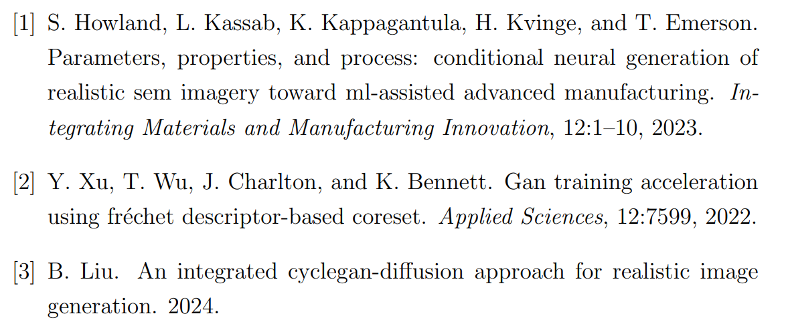
Reference

Slide 26
Thank You

